Slide 1
Rank Order List & Matching
Career and Professional Advisors
Drs. Susan Kaib, Lisa Shah-Patel, David Guttman, Eric vanSonnenberg and Alison Kirk
January 2024

Slide 2
Learning Objectives
Describe the Rank Order List and Match Timelines
Understand the matching algorithm to create a strategic ROL that aligns with preferences
Explain the potential use of the letter of intent/love letter
Describe the NRMP Code of Conduct

Slide 3
Timeline
January 31- NRMP Standard Registration Deadline for the Match and SOAP
$50 Late fee-additional fee after January 31https://r3.nrmp.org/viewLoginPage
https://r3.nrmp.org/viewLoginPage
February 1- 12:00pm EST- Ranking Opens
Log into R3 to create your Rank Order List
Support Guide: Enter_Certify_ROL_MRM-App.pdf (nrmp.org)
February 28- 9:00pm EST- ROL Deadline
March 11- 10:00am EST- Match Status
March 15- MATCH DAY!

Slide 4
Rank Order List Fees
Standard Registration Fee-$70
In the Main Residency Match, includes the listing of up to 20 unique NRMP program codes on the primary rank order list and up to 20 unique NRMP codes on all supplemental rank order lists combined.
Extra Rank Fee: >20 NRMP program codes, NRMP charges $30 per program code up to maximum of 300 ranks
No more than 300 ranks can be placed on any ROL
Couples’ Fee-additional $45 per partner
Length of Rank Order List Fee: For rank order lists with 100 or more ranks, the following additional charges apply:
100-150 ranks: $50
151-200 ranks: $100
201-250 ranks: $150
251-300 ranks: $200

Slide 5
Rank Order List Tips
Be true to yourself—rank your true preferences, not where you think a program will be ranking you or where you think you will match
Be realistic about your competitiveness-rank programs with a mix of competitiveness
Binding Contract
If it is an advanced program, you need to rank a prelim/TY
Can change your ROL up until the deadline, but you need to CERTIFY each time
Do NOT wait until the last minute to certify your list
Do NOT second guess yourself and change your ROL at the last moment
Do NOT rank programs where you did not interview

Slide 6
The Match Process
https://youtu.be/cnVe_NYIVAE
ERAS-residency application and some interview invites
NRMP-for you to rank programs and for programs to rank you
You need to register for NRMP!

Slide 7
Creating a ROL Video
https://www.youtube.com/watch?v=_WX75HnJREI

Slide 8
Supplemental ROL
Your advanced program list is your primary ROL
If ranking an advanced program (PGY-2), you will need to submit a supplemental ROL which is linked to one or more advanced programs on the primary ROL
This combination→PGY2 +PGY1 position=full course of training
Can create different supplemental ROL and each supplemental ROL can be attached to any number of advanced PGY2 programs or primary ROL
Supplemental ROL are often based on geographic location

Slide 9
Supplemental ROL Video
https://youtu.be/X5tz_6dVetU?list=PLr0LH_NifZSpvQTwTqXVYn9jXfUKOTFN6

Slide 10
Supplemental List
Do I need a supplemental list?
Yes, if you are applying to advanced programs
Joint Advanced/Preliminary (A/P) program
Their prelim program will have a restricted, specific code. You’ll add that code to your supplemental list associated with that program. You can add other prelims to that supplemental list, but you cannot use that list for any other advanced programs on your list.
Can I make a supplemental list if my programs are categorical? No
Can I rank preliminary or transitional years on my primary ROL? Yes
Pros and Cons of this approach

Slide 11
Couples Matching
Set up meeting between couple and both advisors
Each partner can rank up to 20 unique program codes, including the “No Match” option, on a primary rank order list and up to 20 on supplemental rank order lists for the base registration fee. After that, each program is $30
A program for one partner can be paired a variety of ways with a program for the other partner
Consider decoupling so at least one of you can match
300 unique program codes including “no match” option can be listed on ROL

Slide 12
Couples Matching Links
NRMP guide
Applicant_Coupling-App.pdf (nrmp.org)
Video:
Couples in the Match | NRMP
UACOM-Phx Couples’ Guide available from your Advisor

Slide 13
Match Results and SOAP 2024-Match-Week-and-SOAP-Schedule.pdf (nrmp.org)
March 11-10am ET-Applicants learn if they matched
March 11-11am ET-SOAP begins
If you have not matched, come to campus to work with your advisor/ADSA or work with them through zoom/phone
SOAP preparation-applicants can begin preparing applications in ERAS at 11am ET
March 12-8am ET-Programs begin reviewing SOAP applications and can contact applicants for interviews
March 14-4 rounds of SOAP starting at 9am ET
Each round is 2 hours long and applicants receive offers at the beginning of each round and must accept/reject offer before round is complete
March 15-12 ET-Match Day!

Slide 14
Love Letter/Letter of Intent
First confirm your specialty/program preference about post-interview communication
You are NOT required to send a love letter/letter of intent
Could be done to indicate that you are ranking a program #1
Send to Program Director and copy the Program Coordinator
Briefly remind them who you are---refer to specific conversations/elements of your interview day and how/why you would be a good fit
If you send this, be 110% sure as there is NO going back
Do NOT expect a response back from the program
“We are ranking you to match” response
Be honest and true to yourself; speak to your advisor prior to sending this
Ideal time to send this

Slide 15
Letter of Intent Example
Dear Dr. _____________,
Thank you again for the opportunity to interview at _____________. I am excited to share with you that I will be ranking ___________ #1 on my rank order list.
My interactions with faculty and residents at ___________________ and the unparalleled culture and sense of family, strong training in multiple practice settings, variety of track options and electives truly excites me. Furthermore, _____institution’s name commitment to the underserved (add specific population) aligns with mine, and I believe this program would be a great fit for me (Consider adding something about the mission and values here).
My parents and siblings also live nearby in Gilbert, and having their support during residency would be invaluable to my fiancé, (insert name and NRMP ID) and me as we couples match. (Consider sharing any personal situation here such as couples matching/geographic preference due to family etc). I am confident that ___________ is a perfect fit to allow me to further develop and strengthen my professional and personal goals within the field of ________________ and I hope that we can work together in the future.
Kind regards,
Your name
MD/MPH Candidate, Class of 2023
University of Arizona College of Medicine - Phoenix
AAMC ID:
NRMP ID:

Slide 16
Alternative-I like you letter (but not LOVE you)
If you decide to tell a program that you are ranking them highly, essentially means you are not ranking them #1
Pros/Cons
Discuss with your Advisor

Slide 17
NRMP Code of Conduct NRMP-Match-Codes-of-Conduct_Applicants.pdf
Limit post-interview communication-During recruitment season, applicants may not have adequate time to obtain the information needed to make informed decisions about ranking programs and may wish to clarify information following interviews. Applicants may request and exchange clarifying information with programs following the interview but must not solicit or engage in post-interview communication for the purposes of influencing or ascertaining a program’s ranking intentions.
Rank and match with integrity-Applicants should create rank order lists based on their true preferences, the characteristics of the programs interviewed, and the perceived alignment of the applicant’s capabilities and interests with program mission, aims, and eligibility. Applicants must respect the binding nature of a match commitment and be prepared to honor the commitment if a match occurs with any program placed on a rank order list
Ethical and professional communication between applicants, program directors and staff, and medical school officials, faculty and staff is essential to maintaining a fair and equitable process throughout the transition to residency. Match participants that fail to comply with their respective Code of Conduct or the terms of the applicable Match Participation Agreement may be subjected to a violation investigation as described in the Policies and Procedures for Reporting, Investigation, and Disposition of Violations of NRMP Agreements

Slide 18
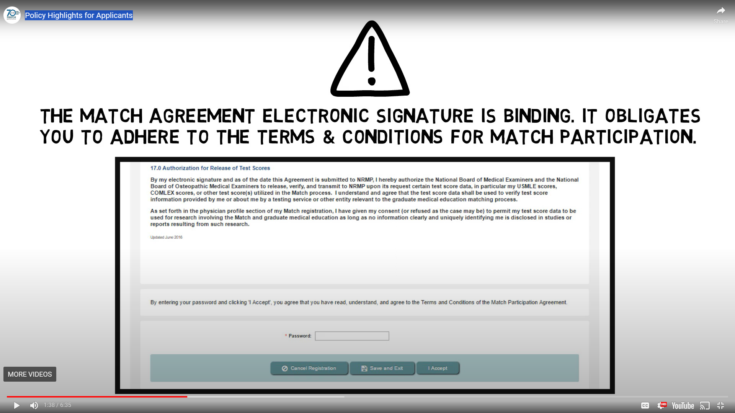
NRMP-Match-Codes-of-Conduct_Applicants.pdf

Slide 19
If you forget everything else, remember…
Always rank your preferences and don’t wait until last minute!!!

Slide 20
Questions?
You’ve got this!!

Slide 21
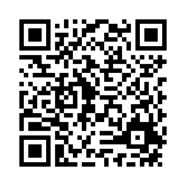
LINK TO SURVEY

